Slide 1

Amazon Books Sales Analysis
PRESENTED BY:
M.AKSHITHA
BATCH NO:456

Slide 2
AGENDA
Use Case & Domain Understanding
Business Problem
Objectives of the Project
Web Scraping – Data Collection Details
Process Followed
Dataset Overview
Exploratory Data Analysis (EDA):
Univariate Analysis
Bivariate Analysis
Multivariate Analysis
Hypothesis Testing
Conclusion

Slide 3
Use Case & Domain Understanding
The online book market on platforms like Amazon offers thousands of books across multiple categories, authors, formats (Paperback, Hardcover, Kindle, Audiobook), and price ranges.
This project focuses on analyzing Amazon Books data to understand how price, ratings, reviews, and book formats influence customer purchasing behavior and book popularity.

Slide 4
BUSINESS PROBLEM
Online book buyers on e-commerce platforms like Amazon are faced with an overwhelming number of book options across multiple formats (Paperback, Hardcover, Kindle, Audiobook), price ranges, authors, and customer ratings.
Inconsistent pricing across similar books
Unclear relationship between price and customer ratings
Difficulty in identifying popular and highly rated books
Confusion between different book formats and their pricing

Slide 5
OBJECTIVE OF THE PROJECT
Analyze the price distribution of books across different formats
Understand the relationship between book price, ratings, and number of reviews
Identify popular books and authors based on ratings and review counts
Compare book formats (Paperback, Hardcover, Kindle, Audiobook) in terms of pricing and popularity
Categorize books into price and rating segments for better insights
Provide actionable insights to help customers make smarter purchasing decisions

Slide 6
WEB SCRAPING -DETAILS
The dataset for this project was collected by web scraping Amazon book listings using Python. Relevant information was extracted from multiple pages to ensure sufficient data volume and variety.
TOOLS AND TECHNOLOGIES USED
Python
Selenium
Webdriver manager
Pandas
Matplotlib and seaborn

Slide 7
PROCESS FOLLOWED
Identified required book attributes from Amazon listings
Scraped data across multiple pages
Cleaned raw data by handling missing values and inconsistencies
Converted text-based numeric fields into proper numerical formats
Created derived columns such as:
Rating Category
Price Category
Popularity Category

Slide 8
DATASET OVERVIEW
Source: Amazon India (Web Scraping using Selenium) Rows and columns: Book listings with attributes related to pricing, ratings, formats, and popularity
Key Features: • Book Name – Title of the book • Author Name – Author(s) of the book • Price – Selling price of the book (₹) • Book Format – Paperback, Hardcover, Kindle Edition, Audiobook • Customer Feedback – Ratings and Number of Ratings
Data Types: Mix of numerical (price, rating, ratings count) and categorical (author, format, categories)
Purpose: To analyze pricing patterns, book format trends, customer preferences, and value-for-money insights to support smarter book-buying decisions

Slide 9
SIMPLE DESCRIPTION OF EACH COLUMN IN DATASET
Book Name:-Title of the book listed on Amazon
Author Name:-Name of the author(s) who wrote the book
Price:-Selling price of the book in Indian Rupees (₹)
Number Of Ratings: Total number of customer ratings received for the book
Review (Rating):Average customer rating of the book (out of 5)
Book Format: Format in which the book is available (Paperback, Hardcover, Kindle Edition, Audiobook)
Released Year: Year or date when the book was published or released
Price Category: Price-based classification of books (Budget, Low-Mid, Mid, Upper-Mid, Premium)
Rating Category: Rating-based classification (Poor, Average, Good, Excellent)
Popularity Category: Popularity level based on number of ratings (Low, Medium, High, Very High)

Slide 10
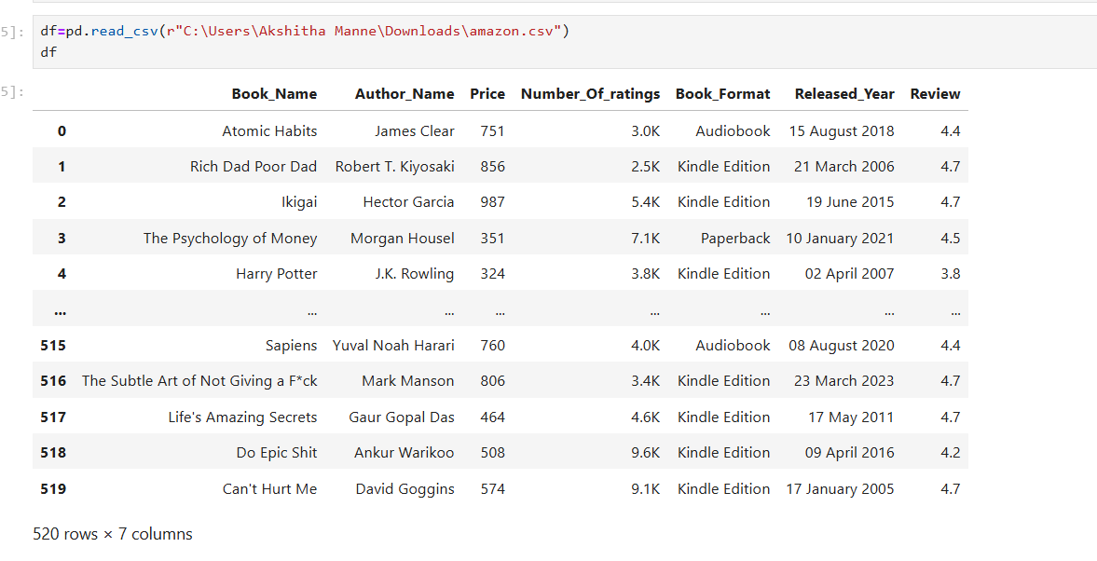
CLEANED DATASET

Slide 11
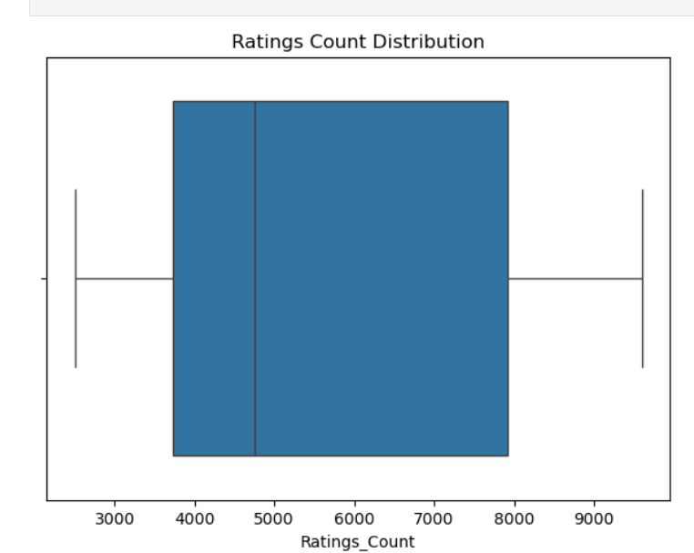
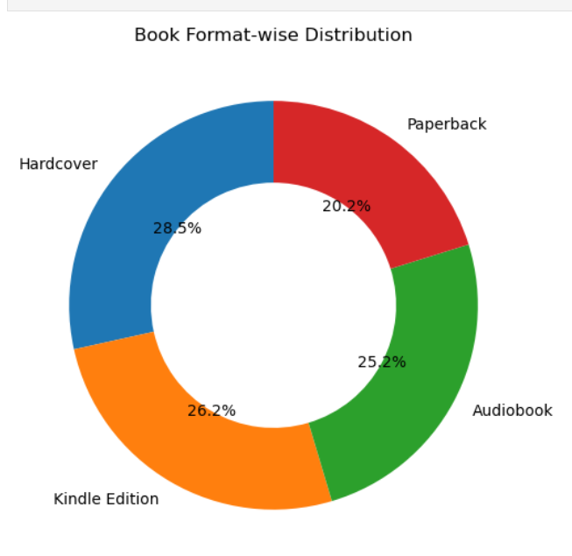
UNIVARIATE ANALYSIS
The ratings count distribution shows that while most books receive moderate engagement, a small number of books attract exceptionally high popularity, indicating a right-skewed visibility pattern.
The format-wise distribution shows a balanced demand across hardcover, digital, and audio formats, highlighting evolving reader preferences and strong multi-format consumption on Amazon.

Slide 12
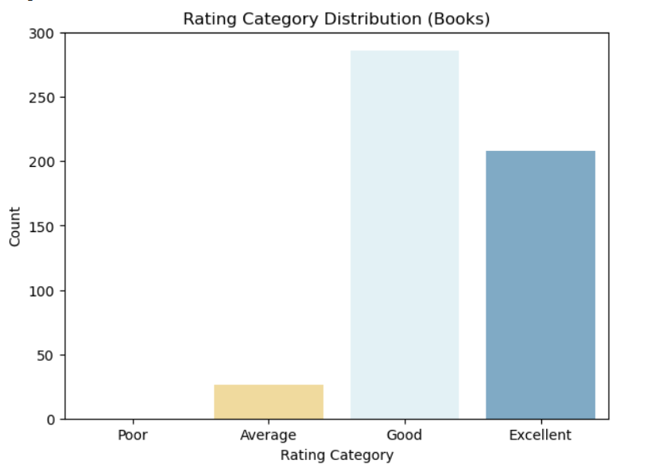
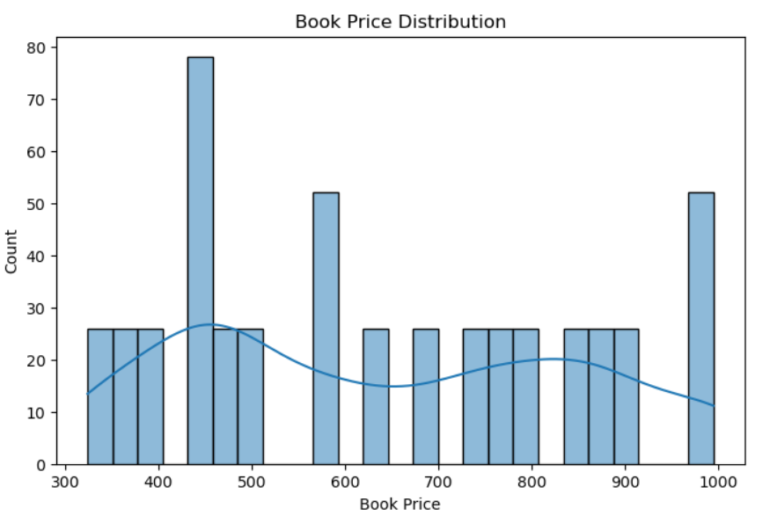
The rating distribution clearly shows that most Amazon books receive good to excellent customer ratings, indicating high content quality and strong reader satisfaction.
The price distribution shows that most Amazon books are priced in the mid-range, indicating strong demand for affordable yet high-quality books, with limited presence of premium-priced titles.

Slide 13
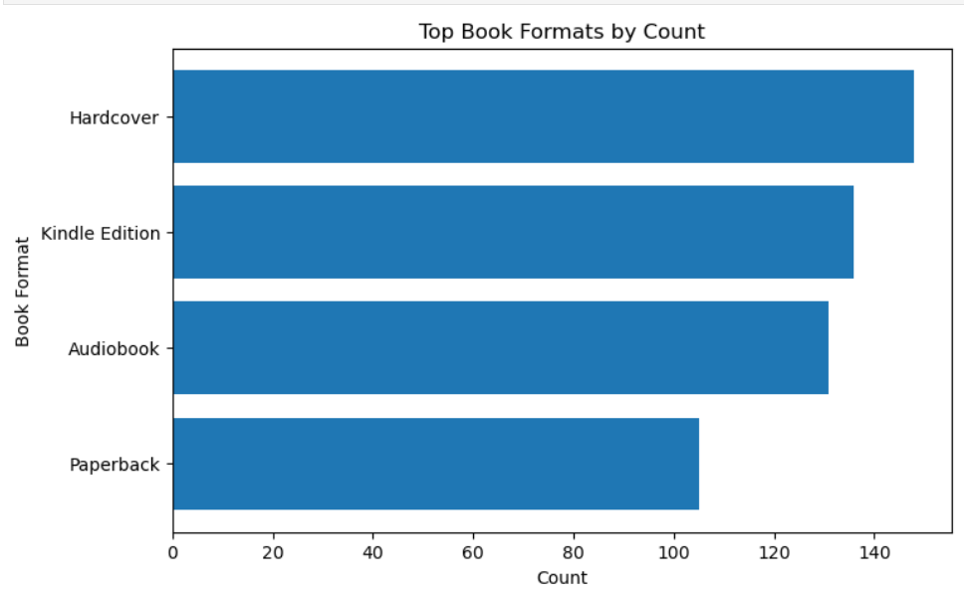
Physical and digital formats coexist strongly
Hardcover dominance suggests premium positioning
Kindle and Audiobook formats indicate technology-driven reading habits
Paperback availability is comparatively lower in this dataset

Slide 14
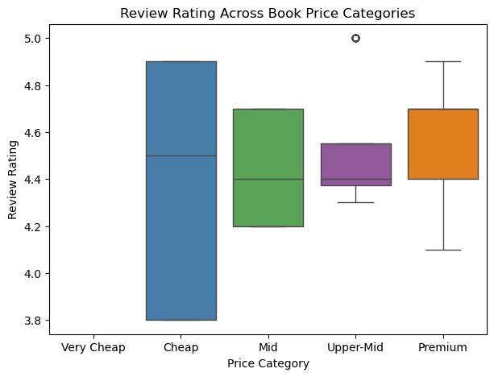
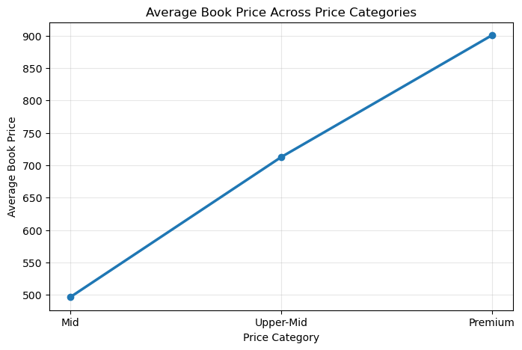
BIVARIATE ANALYSIS
While premium books generally maintain strong ratings, the Upper-Mid price category stands out as the most reliable segment, offering consistently high customer satisfaction. Lower-priced books show greater variability, highlighting opportunities for identifying hidden value titles as well as quality risks.
It validates both the pricing structure and business segmentation. This insight helps stakeholders confidently design pricing tiers, promotions, and inventory strategies.

Slide 15
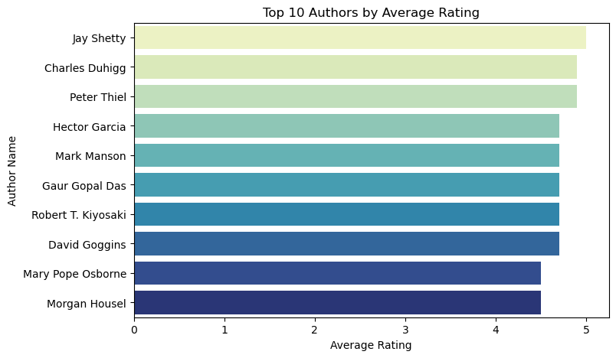
Consistently High Author Ratings Reader Trust in Certain Authors Non-Fiction & Self-Development Dominance
Quality Over Quantity

Slide 16
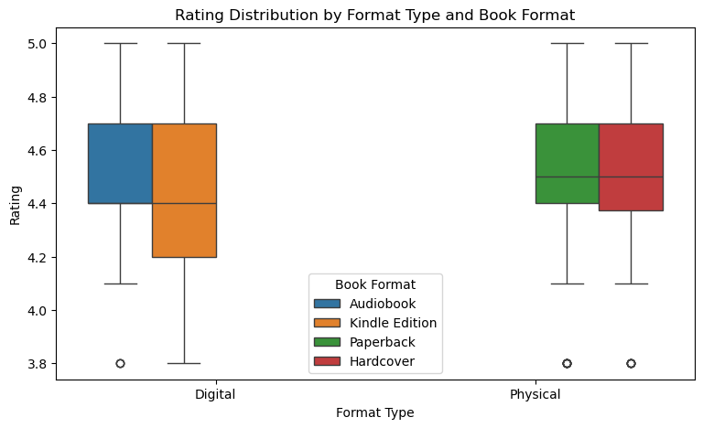
MULTIVARIATE ANALYSIS
This multivariate analysis shows that book format and format type mildly influence customer ratings, with physical books and audiobooks performing slightly better in terms of consistency and median ratings. However, overall customer satisfaction remains high across all formats, making format diversification a strong strategy for Amazon Books.

Slide 17
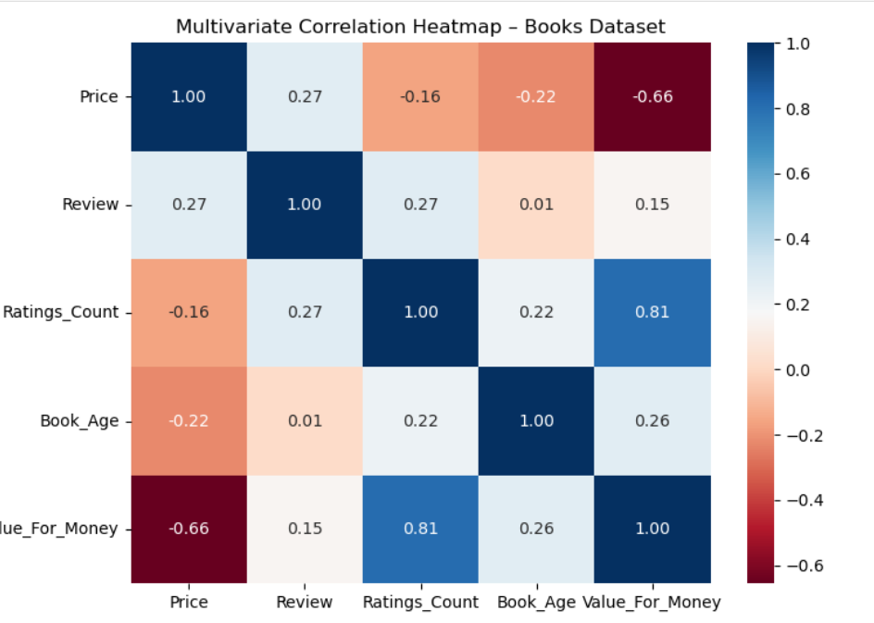
Price alone is a poor indicator of customer satisfaction
Popularity (ratings count) strongly drives perceived value
Older books remain relevant and valuable
Value-for-money perception depends more on social proof than cost

Slide 18
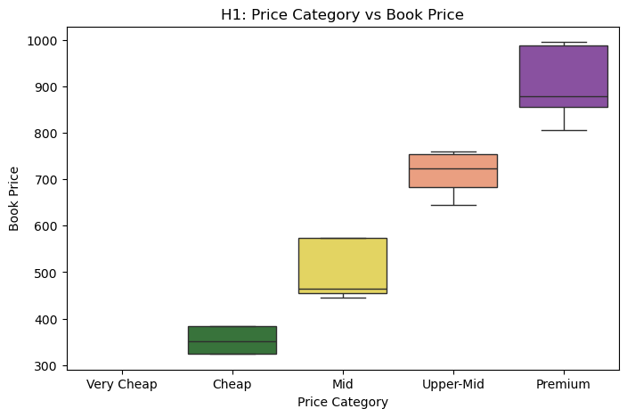
HYPOTHESIS TESTING
It confirms that book prices differ significantly across price categories, validating clear and meaningful segmentation from budget to premium books.”

Slide 19
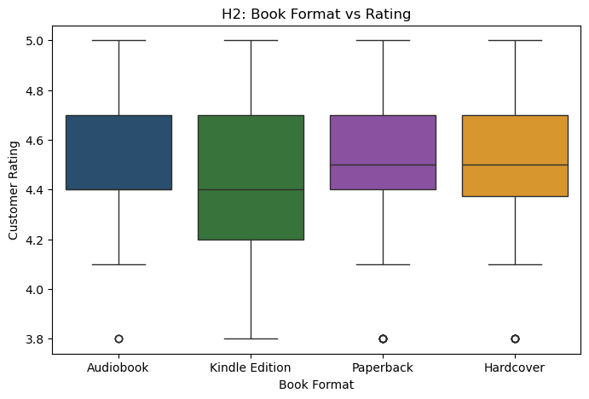
Customer ratings do not significantly differ across book formats, indicating that content quality outweighs format preference in driving reader satisfaction.

Slide 20
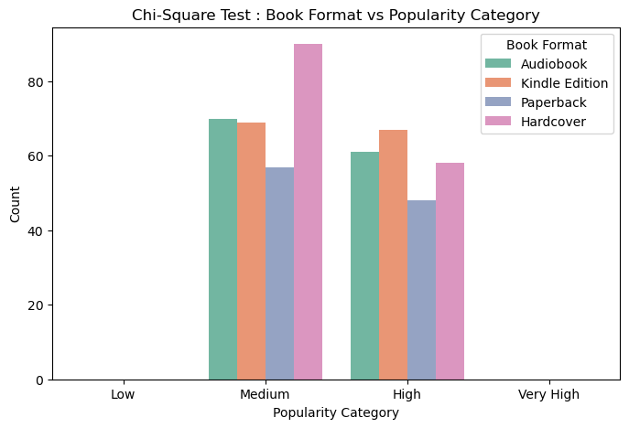
Different book formats attract different levels of popularity. All formats are not equally liked by readers.
Hardcover and Audiobook versions are most common in the “Medium” and “High” popularity range.

Slide 21
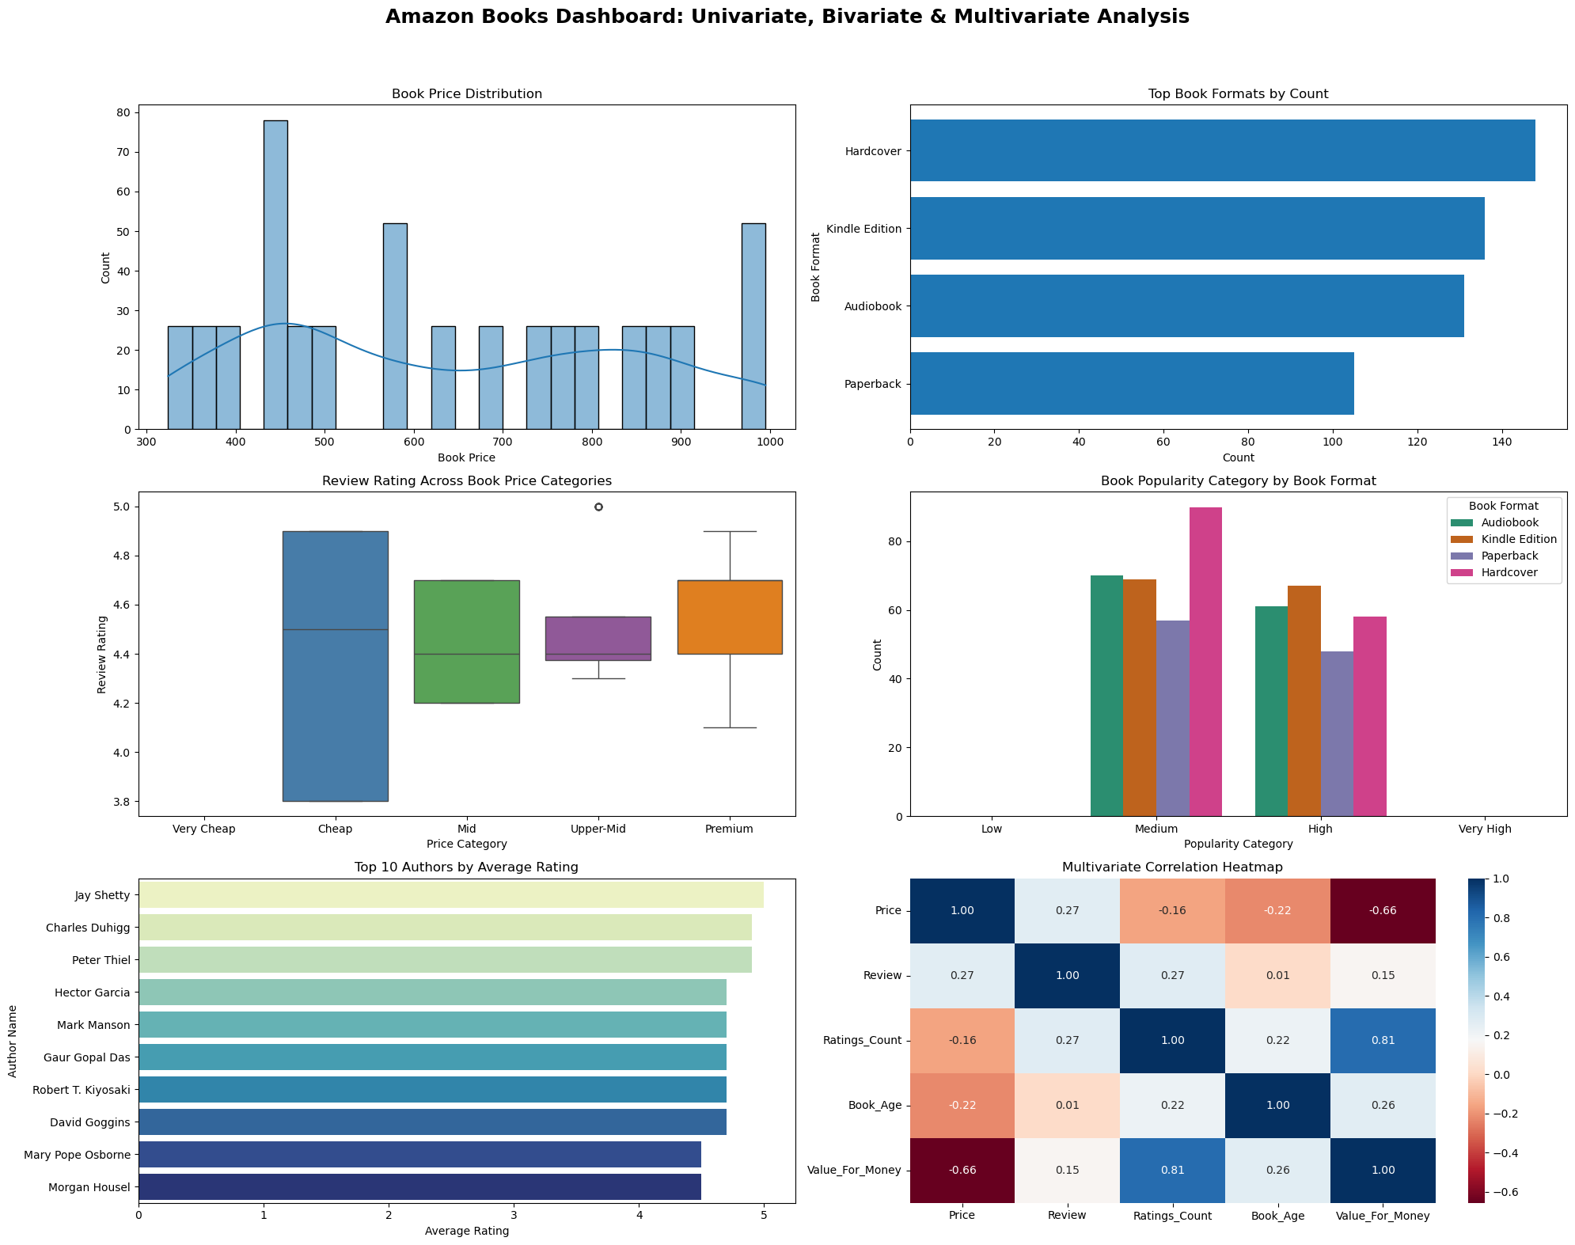

Slide 22
CONCLUSION
This project performed an end-to-end Exploratory Data Analysis (EDA) on Amazon Books data to understand pricing behavior, customer ratings, popularity trends, and value-for-money patterns across different book formats and categories.
The analysis revealed that book format plays a significant role in pricing and customer engagement. Digital formats such as Kindle and Audiobooks are generally priced lower but receive higher ratings and engagement, while physical formats (Hardcover and Paperback) tend to be priced higher with comparatively moderate ratings.

Slide 23

THANK YOU

